Slide 1
Computer Organisation 1
  Secondary Storage
  Part 2
Sébastien Piccand
sebastien.piccand@ul.ie

Slide 2
Technologies
Magnetic storage
  Floppy, Zip disk, Hard drives, Tapes
Optical storage
  CD, DVD, Blue-Ray, HD-DVD
Solid state memory
  USB flash drive, Memory cards for mobile phones/digital cameras/MP3 players, Solid State Drives

Slide 3
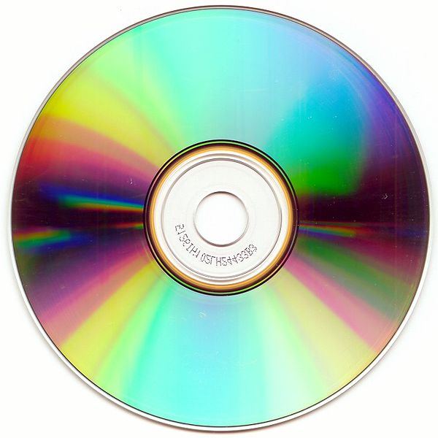
Optical storage
http://www.cdrfaq.org/
http://www.dvddemystified.com/dvdfaq.htm

Slide 4
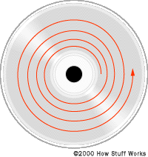
Optical storage: CD
Laser reads the data from the bottom
CD= Compact Disc
One track

Slide 5
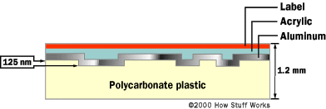
Optical storage: CD
Data: pits and lands
  Bit 1: transition between pit and land
  Bit 0: flat

Slide 6
Optical storage: CD
CD-Audio, CD-ROM
  Pits and lands
Recordable and rewritable CD
  Dye in different states
    CD-R (Recordable): heat the dye (250 C) to melt/modify
    CD-RW (Rewritable): the material can take two different phases (crystalline and amorphous)‏

Slide 7
Optical storage: CD-R
CD-R structure
  [optional] label
  [optional] scratch-resistant and/or printable coating
  UV-cured lacquer
  Reflective layer (24K gold or a silver alloy)‏
  Organic polymer dye
  Polycarbonate substrate (the clear plastic part)

Slide 8
Optical storage: CD-RW
CD-RW structure
  [optional] label
  [optional] scratch-resistant and/or printable coating
  UV-cured lacquer
  Reflective layer (aluminum)‏
  Upper dielectric layer
  Recording layer (phase change film, i.e. the part that changes form)‏
  Lower dielectric layer
  Polycarbonate substrate (the clear plastic part)‏

Slide 9
Optical storage: DVD, BD...
DVD
  Digital Video Disc
  Digital Versatile Disc
  Recordable: DVD-R and DVD+R
  Rewritable: DVD-RW, DVD+RW
BD: Blu-ray disc
HD-DVD: High Definition DVD
  Lost war against BD...

Slide 10
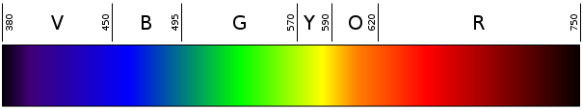
Optical storage: DVD, BD...
CD vs DVD vs HD-DVD/BD
  Type of laser
    CD: 780nm (infrared)‏
    DVD: 635nm or 650nm (visible red)‏
    HD-DVD/Blu-ray Disc: 405nm (visible blue)‏

Slide 11
Optical storage: DVD, BD...
CD vs DVD vs BD/HD-DVD
  Different Laser
  -> Size of track and size of pits/lands
CD-R -> DVD-R, DVD+R, HD-DVD-R, BD-R
CD-RW -> DVD-RW, DVD+RW, HD-DVD-RW, BD-RE
DVD-RAM: DVD-RW where data is represented on track/sectors

Slide 12
Optical storage
Multi layer DVD/HD-DVD/BD
  Semi transparent layers
  Focusing on the layer
  -> More space on one disc

Slide 13
Optical storage
Capacity
  CD: 650 MB, 700 MB
  DVD: 4.7 GB per layer, up to 2 layers
  HD-DVD: 15 GB per layer, up to 3 layers
  BD: 25 GB per layer, up to 2 layers

Slide 14
Optical storage
Performance
  CD: 1X=150kbit/sec, up to 52x
  DVD: 1X=10.5Mbit/sec, up to 20X
  HD-DVD: 1X=36Mbit/sec=4.5 MB/sec, up to 2X ?
  BD: 1X=36Mbit/sec, up to 12X

Slide 15
Optical storage
Reliability
  CD-Audio, CD-ROM, DVD, HD-DVD, BD
    Avoid extreme cold/heat
    Scratches, especially from the top
  CD-R, CD-RW, DVD-R, DVD+R, DVD+RW, HD-DVD-R, HD-DVD-RW, BD-R, BD-RE
    Avoid extreme cold/heat
    Scratches
    Avoid direct sun light (change dye property)‏

Slide 16
Optical storage: future
Holographic Versatile Disc
  3.9 TB
LS-R: Layer-Selection-Type Recordable Optical Disk
  1 TB
Protein Coated Disc
  50 TB!

Slide 17
Technologies
Magnetic storage
  Floppy, Zip disk, Hard drives, Tapes
Optical storage
  CD, DVD, Blue-Ray, HD-DVD
Solid state memory
  USB flash drive, Memory cards for mobile phones/digital cameras/MP3 players, Solid State Drives

Slide 18
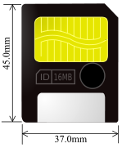
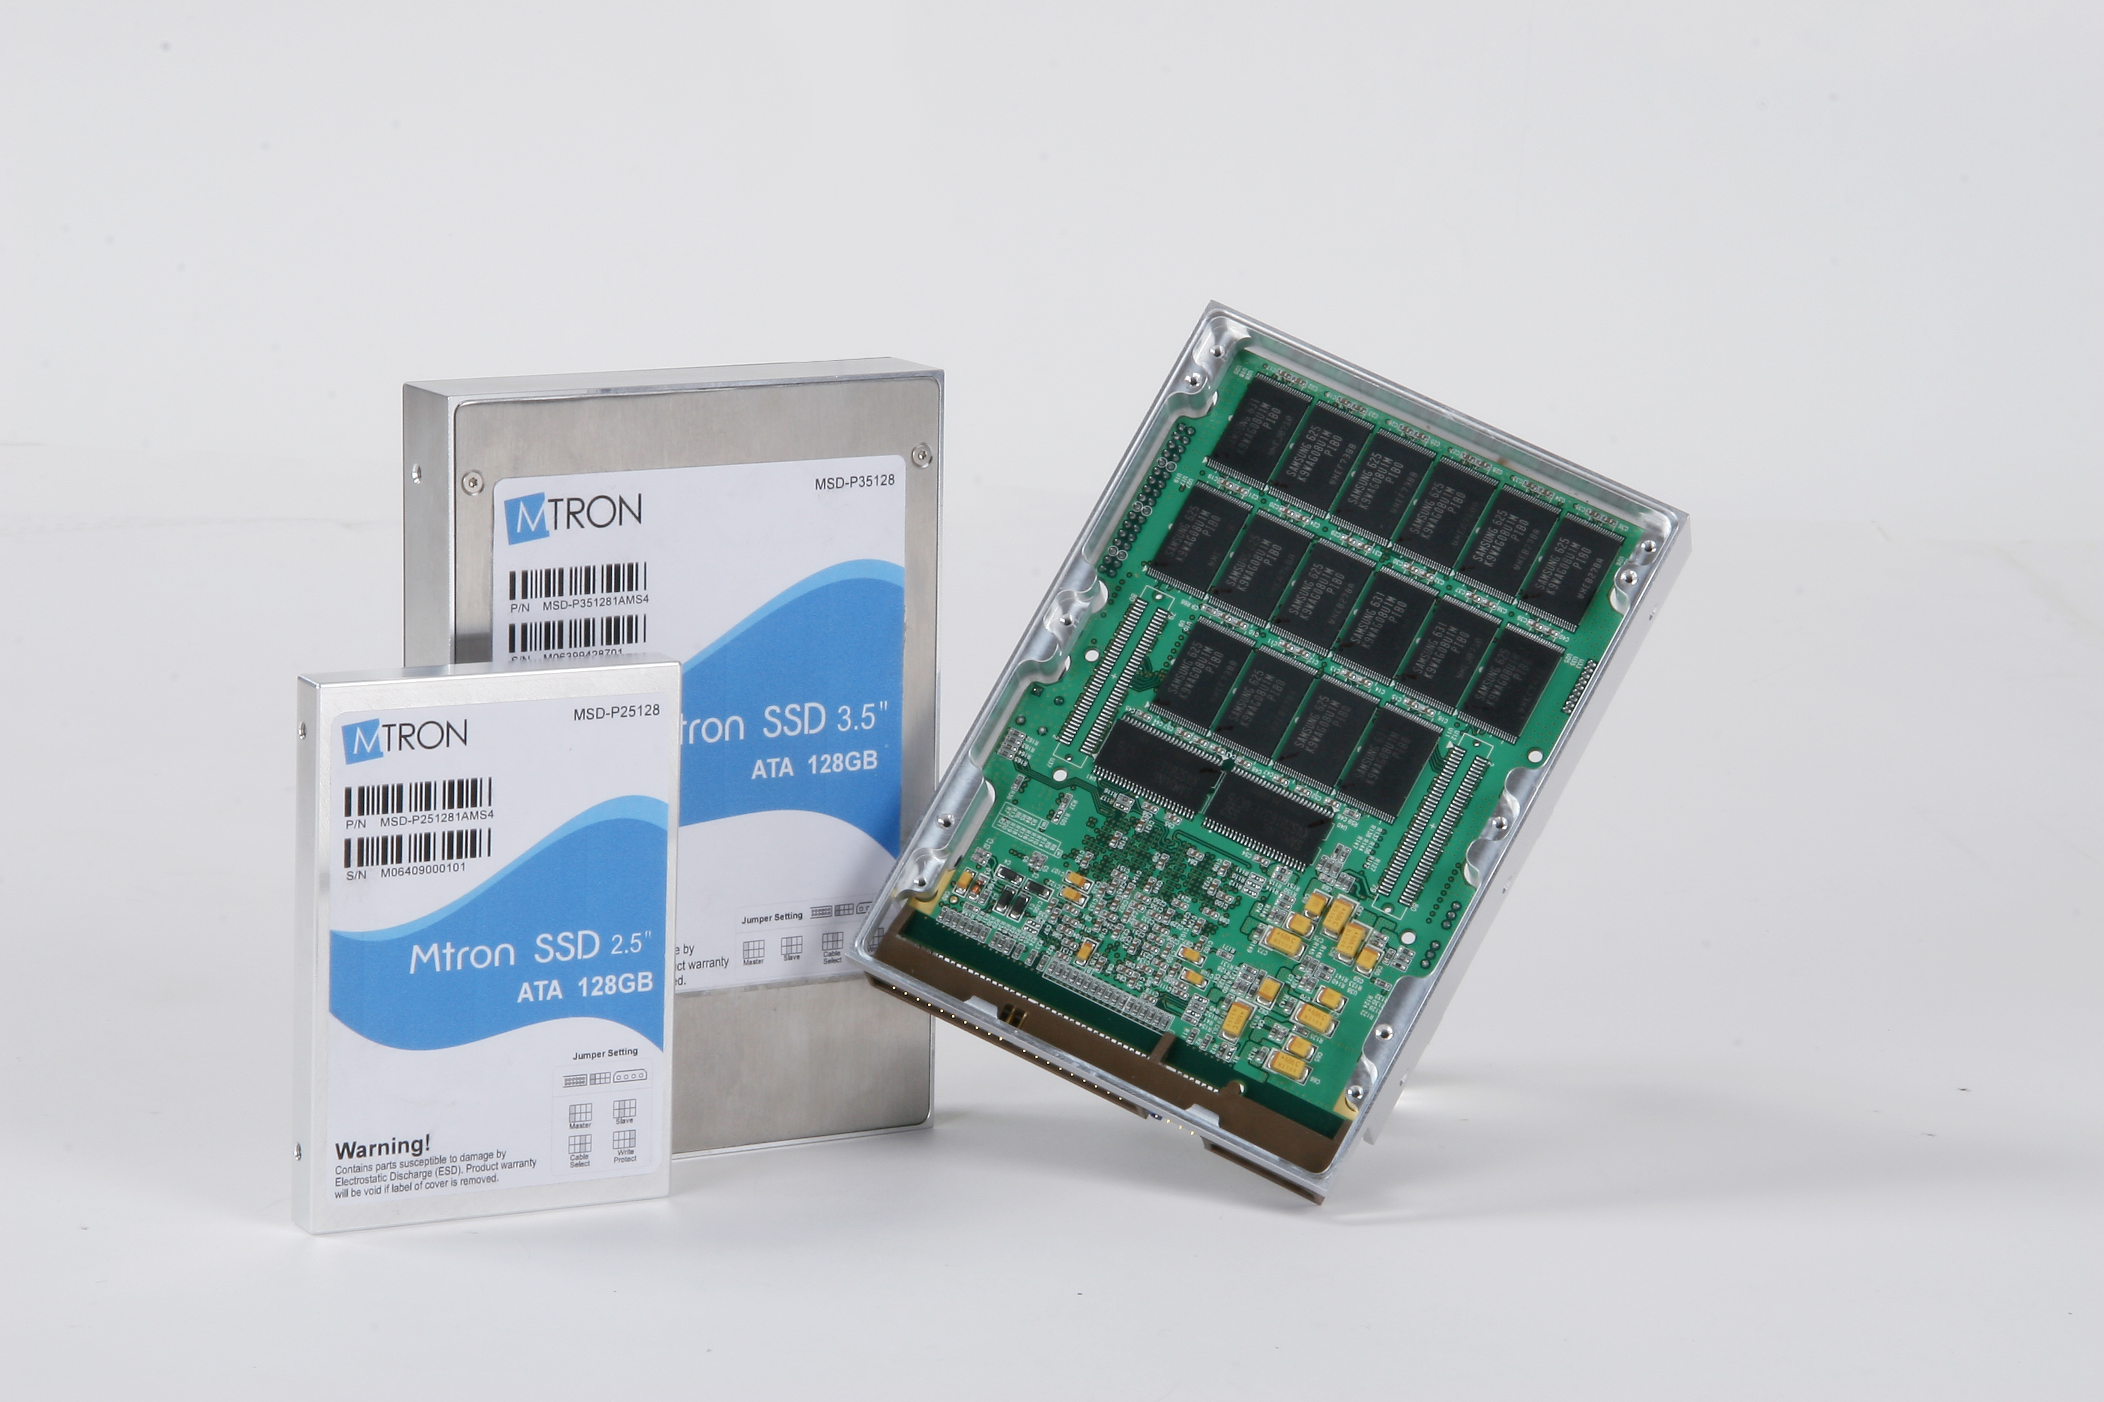
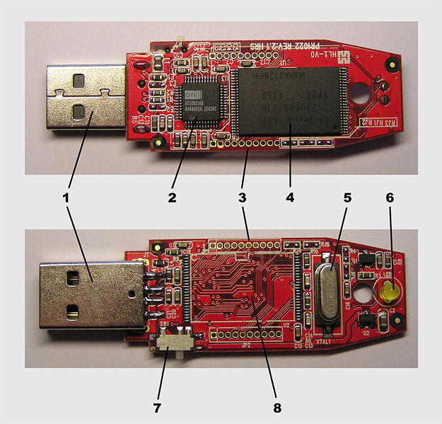
Solid state storage

Slide 19
Solid state storage
Memory cards
  For Digital cameras, mobile phones, MP3 players...
  Many types: Compact flash, Smart Media, Memory Stick, Secure Digital card...
USB flash drives
  Replace floppies/CD-RW
Solid State Drives
  Replace traditional hard disks

Slide 20
Solid state storage
Uses flash memory
  Type of EEPROM
    Electrically erasable programmable read only memory
  Grid of cells (1 cell = 1 bit)‏
  Write/erase cells by blocks

Slide 21
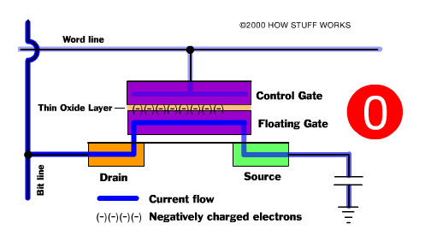
Solid state storage
Cell=two transistors
  Bit 1: no electrons in between
  Bit 0: many electrons in between

Slide 22
Solid state storage
Size
  Very small: 1cm² for some memory cards
Capacity
  Memory cards: up to 32 GB
  USB flash drives: up to 32 GB
  Solid State Drives: up to 256 GB

Slide 23
Solid state storage
Performance
  Acces time: 10X faster than hard drive
  Transfer rate
    1x=150 kb/sec, up to 100X for memory cards
    similar to normal hard drive for SSD ( 100-150 MB/sec)‏
  Limited write: 100k to 1,000k cycles

Slide 24
Solid state storage
Reliability
  Resists to shocks
  Silent!
  Avoid extreme heat/cold
  Limited number of erase/write

Slide 25
Solid state storage
Challenges
  Increasing size
  Improving writing limits

